Slide 1
Responsive Web Design
Aidan Ryan, Technical Sales Engineer
Notes:
Peer Reviewed by:
Daniel Hester
Principal Consultant, Magenic
October 2013

Slide 2
Agenda
Defining Responsive Web Design
Core Techniques:
Responsive Grid Frameworks
CSS Media Queries and Server-side Techniques
Finding your Break Points
Responsive Media:
Images, Videos, Forms, Typography and Fonts
Case Study
Notes:
This topic has been developing over the past 2 years or so. Many people – smarter than us – have contributed to the ideas that we are about to present. Our intention is to present a survey of current thinking and techniques regarding Responsive Web Design, and to demonstrate the application of these ideas through a simple case study. We’ll focus on Visual Studio 2012 / ASP.NET tools and techniques for getting the job done.
WE WILL BE RESPONSIVE TO YOU:
How many people have heard the term “Responsive Web Design”?
How many people have a pretty good understanding of what it is?
How many people have used it?

Slide 3

“Best viewed with IE 5.5 at 800x600, color depth 15bpp, with a parakeet on your shoulder”
Notes:
Remember this?

Slide 4
Defining Responsive Web Design
Opposite of “prescriptive”
Responds to:
Browser capabilities
Device capabilities
User capabilities
Viewport size and orientation
Notes:
Responsive design is the polar opposite of prescriptive design, e.g. “Best viewed on IE 5.5 in 800x600 with a color depth of 15bpp.”
Prescriptive design forces requirements on the user and the user’s browser; a prescriptive design needs certain screen sizes, a keyboard and mouse to navigate effectively, or certain plugins, etc.. A responsive design inquires about the capabilities/imitations of the consuming client (browser/device/user) and puts forth the best possible experience given those capabilities/limitations. Responsive designs are fully functional in limited scenarios and progressively enhance the user’s experience as the user’s capabilities (and screen real estate) increases.
Responsive designs respond to:
Browser capabilities (HTML5 e.g. audio/video, CSS3, plugins)
Device capabilities (geo-location, resolution, touch versus mouse and keyboard)
User capabilities (accessibility – screen readers, etc.)
Viewport size, orientation and on mobile/tablet computers – the resolution (e.g. pixel density on retina displays) and portrait versus landscape mode. On desktops the browser window is not always maximized.
The term “Responsive” in this context was first coined by Ethan Marcotte (writing for A List Apart); he co-opted ideas from “Responsive Architecture” – where the classic example is the design of conference room walls that adjust their opaqueness when a projector is turned on.
The term “Viewport size” means the visible area of the browser window. On desktops and laptops (and to some degree tablets) the dimensions change when the browser window is maximized or resized and on tablets and smartphones the dimensions change when the tablet or smartphone is held in landscape or portrait mode.

Slide 5
Response Web Design: Why?
The rise of mobile and tablet computers over traditional desktops and laptops (aka the “Consumerization of IT”)
Balance of reach and effort required to achieve it: know thy audience
Consistency: avoid “Franken-edits” of your design by mobile devices
Prioritize your message: most valuable things first
User joy and engagement
Notes:
The Consumerization of IT:
http://en.wikipedia.org/wiki/Consumerization
The emergence of consumer markets as the primary driver of information technology innovation is now seen as a major IT industry shift
90% of phones today can browse the web
By 2014 Mobile Internet usage will overtake Desktop usage
Half of all local searches are done from a Mobile device
Web sites optimized for Mobile form factors have fewer defections and a longer average time spent on the site when viewed from a mobile device
The sweet spot for responsive design is a balance of device reach and development effort. A good responsive design will help get your content in front of a larger number of eyeballs, in a more usable way, with the least effort.
Cheapest Design: design for the desktop and cross your fingers on mobile. Lots of mobile users will “bounce” from your site.
Most Expensive Design: a separate design for phones, tablets, and desktops. May deliver the most optimal experience on each device, but can cost a lot more to develop and maintain.
With a responsive design you will deliver a consistent experience across devices. Styling, navigation, and User eXperience (UX) will be familiar and help your users transition between the different presentations of the site. You also have one set of HTML and styling resources to maintain – changing one naturally changes them all.
We recommend seriously considering a “mobile first” approach to your website’s design even if you end up implementing a “desktop first” design. A “mobile first” approach forces you to examine your site’s core message and the value you’re delivering. Once you’ve gone through this exercise you can then decide how to best present your content. The tendency when approaching a single platform can be to dive into wireframes and “comps” before the content is fully realized or before you’ve done you’ve done your homework on your users and what they’re coming to site for:
http://xkcd.com/773/
Responsive design is about delivering the greatest possible user joy regardless of the access method. It is not a dogma or a recipe, it’s more of a mindset that is focuses on User eXperience first.

Slide 6
Response Web Design: Why Not?
Audience doesn’t care
The Cost/Time/Benefit Analysis says “No”
Need for highly-targeted designs that are “fixed width” based
Only need a subset of responsive techniques on a subset of site
Notes:
Check your logs! Analyze your web traffic! 2% access from mobile devices probably won’t justify the effort and expense.
Responsive design might take twice as long to design and implement compared to fixed-width designs.
Design may be compromised by having to work at many viewport sizes; some designs won’t work at smaller sizes. The alternative is to find a canvas size that comfortably renders on almost all desktops as well as on tablets, e.g. 980px width.
Understand the objectives of your users accessing your site on different device platforms; are they trying to do the same thing or are their objectives different?
https://gocardless.com/blog/unresponsive-design/

Slide 7
Response Web Design: Brief History
Ethan Marcotte – Responsive Web Design
Jason Grigsby – CSS Media Query for Mobile is Fool’s Gold
Approx. 2.9e+9 articles, galleries, samples, etc
May 2010
John Allsopp – A Dao of Web Design
April 2000
April 2013
August 2010
Luke Wroblewski –Mobile First
October 2011
Notes:
http://alistapart.com/article/dao
Summary: Letting go of control in favor of accepting and adapting to client differences.
http://alistapart.com/article/responsive-web-design
Summary: Original articulation of responsive web design principles.
http://blog.cloudfour.com/css-media-query-for-mobile-is-fools-gold/
Summary: First major rebuttal, warning that bandwidth suffers because additional HTML, CSS, and (potentially) JavaScript – i.e. more code – is required to render your site on a smaller screen. Important for pivoting the discussion towards general adaptability and away from a mobile “silver bullet.”
http://alistapart.com/article/organizing-mobile (from Luke Wroblewski's “Mobile First” eBook)
Summary: Refinement of responsive web design approach working from most-constrained to least constrained.

Slide 8
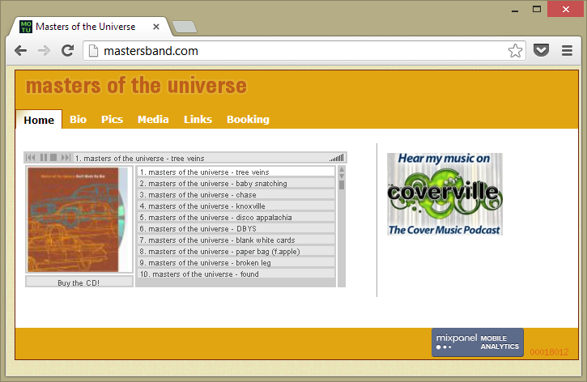
Case Study: Before
Notes:
The Case Study for this presentation is the Masters of the Universe website.
The original site – “Before” – is here:
http://mastersband.com/
The Responsive Redesign – “After” – is here:
http://mastersband.apphb.com
The “Before” design targets desktop browsers and displays well when the browser window is maximized.

Slide 9
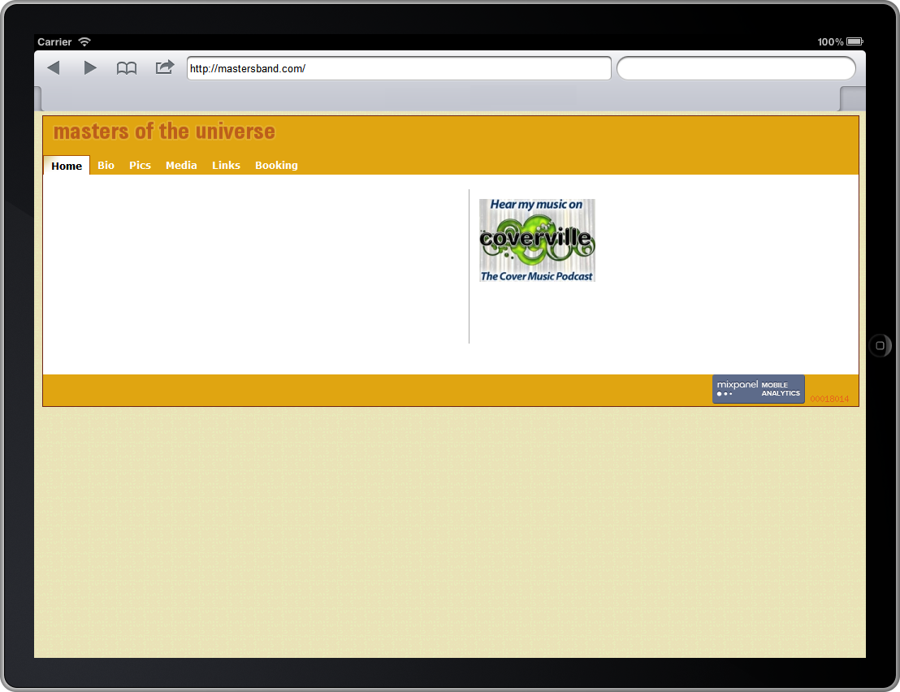
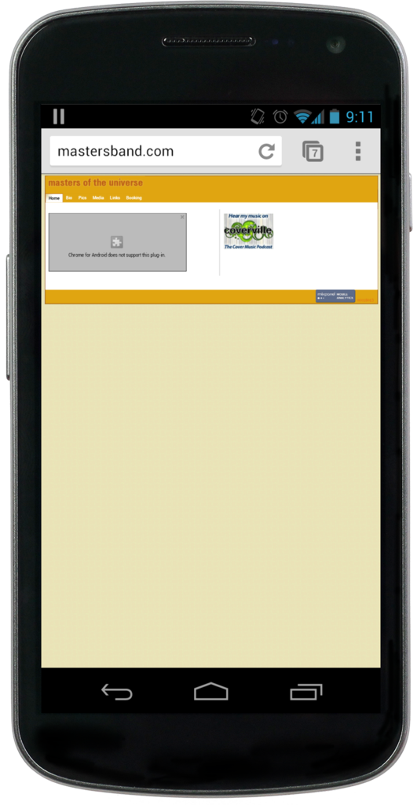
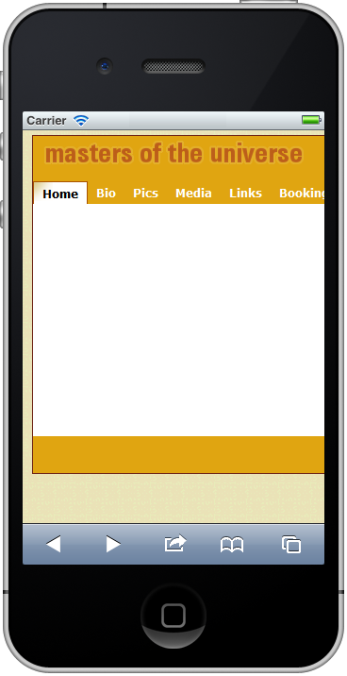
Case Study: Before
Notes:
However, when viewed on tablets and smartphones the site suffers from:
Content issues
Design issues
Either the design looks wrong or the content is rendered way too small in real pixels rather than in device pixels.
We’ll return to the Case Study in the last section of this presentation.

Slide 10
Core Techniques
Responsive Grids: Fluid Grids and Adaptive Grids
Media queries
Responsive media / Server-side techniques for sizing images and video
Ems and the Viewport Meta Tag over Pixel sizing and Point sizing
Notes:
Responsive Grids
Think columns and rows. However, don’t think HTML tables. HTML table-based designs have given way to CSS-controlled grid systems. Any <div> or <span> HTML element can have all of the CSS-controlled properties that you would commonly associate with HTML <table> attributes, e.g. width, height, margin-left, margin-right and additionally, <div> and <span> elements have more sophisticated positioning attributes.
Fluid Grid
A Fluid Grid (and a fluid layout in general) provides a framework for smoothly adjusting to window sizes, resolutions, and densities based upon relative “percentages” rather than pixel heights and widths. The earliest fluid layouts were focused on achieving proportional columns using CSS – a technique that was trivial at the time using the then popular HTML <table> based layouts. Contemporary implementations of fluid layouts are now more focused on typography, especially given the emergence of high-density displays that make pixel-sizing and point-sizing even less reliable.
Adaptive Grid
An Adaptive Grid targets a set of screen sizes and “snaps to” the layout for that screen size when the user changes the size of the browser window or the orientation of the device (portrait / landscape mode). Adaptive Grids rely on a column and row based design. When there’s a large amount of screen real estate the design displays the full compliment of columns and the minimum number of rows; when the viewport size is at its smallest, the design displays a single column, stacks the content into the maximum number of rows, and reduces the menus to a single glyph (e.g. a button). “Break points” are the points where the layout snaps to a new design based on the new size of the viewport.
Media queries
Media queries are a CSS3 feature that allow us to target CSS rules at specific ranges of screen size. *Browser compatibility permitting
Responsive media
Responsive media techniques provide ways to deliver images, video, and audio of the right size/encoding to the consuming device. In its simplest implementation, “right size” simply means client-side scaling of an image to fit the layout. Server-side implementations allow us to serve smaller byte-sized payloads to the client as well (e.g. Netflix on-the-fly encoding), thereby respecting their bandwidth costs and display size.
Ems and the Viewport Meta Tag
The “em” or “M”– literally from the width/size of an M – is a scalable unit that is used in web documents. One (1) em is equal to the device / browser’s default font-size. For instance, if the (default) font-size of this document is 12pt, 1em is equal to 12pt. Ems are scalable in nature, so 2em would equal 24pt, .5em would equal 6pt, etc. Ems are becoming increasingly popular in web documents due to scalability and their mobile-device-friendly nature. The iPhone “lies” about its screen size (pixel dimensions) and therefore it shrinks non-mobile-optimized sites in order to display them. Therefore, use the Viewport meta tag to tell the mobile browser to use the device-width as the initial width of the web page.
Recommendations
DO use the viewport meta tag, i.e. <meta name="viewport" content="...">
For the content attribute:
DO use <meta name="viewport" content="width=device-width, initial-scale=1"> or
DO use <meta name="viewport" content="width=device-width">
For the content attribute:
DO NOT use maximum-scale=1 or user-scalable=no: this will stop mobile uses from zooming in on your content in order to read it
DO NOT use width=<specific width>: unless you have very good reasons
Notes
It is not necessary to use all of these techniques; every application is different. However, a mature Fluid or Adaptive Grid framework potentially combined with a pre-defined base set of styles set can be a nice productivity boost to a project.

Slide 11
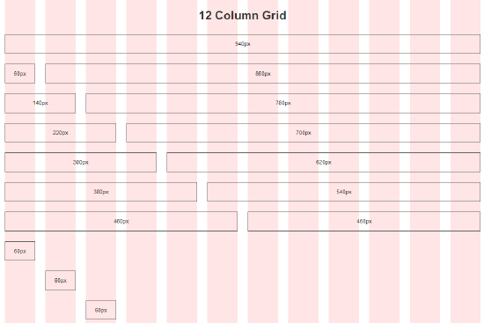
Grid Systems
Fixed
Responsive
Fluid
Fluid + Responsive
Notes:
Implementing a responsive design usually involves implementing a grid system. But which one?
A grid is defined as the division of the canvas into columns and rows with gutters in between. Grids help us think about design, and they help users engage with the website’s content. Think of grids as the dynamic guidelines that pop your elements into place as you drag the elements around, e.g. in a Form designer or on PowerPoint slide.
Several frameworks and generators exist that provide grid systems. They fall into four basic categories:
Fixed: the container width (of the grid) is set to a fixed width, and the column count, column width, and gutter width are also set to fixed measures of the container’s width. Column spanning is possible, but the container will never resize with the window.
Responsive: a set of media queries (often in the CSS) provides a progressive step-down of the container width, column count, column width, and gutter width.
Fluid: the column count is fixed; the container width, column width, and gutter width are all percentages of the canvas
Fluid + Responsive: media queries set the container width and column count; within each “break point” – that is within each optimal layout for each device width, e.g. Desktop, Tablet, Smartphone – the column and gutter widths are proportional.
Using or customizing a pre-existing grid framework versus creating your own is a tradeoff like any other; you’re pitching the limitations of the framework and its learning curve against the productivity boost that the framework provides.

Slide 12
Framework | Classification | Max size | Columns | Notes
960gs | Static | 960px | 12 / 16 | Grid only IE7+ CSS
Skeleton | Responsive | 960px (desktop/tablet-landscape) 768px (tablet-portrait) 420px (mobile-landscape) 300px (mobile-portrait) | 16 | Lightweight CSS framework IE7+ CSS
responsive.gs | Fluid + Responsive | Any Columns stack below 768px | 12 / 16 / 24 | Grid only IE7+ CSS
Bourbon Neat | Fluid + Responsive | Fluid + Responsive | 12 (or custom) | Grid addon to Bourbon IE9+ Sass
Bootstrap | Static OR Fluid OR Fluid + Responsive | Static: 940px Others: Any (nest-able within a container) | 16 | Full client-side framework IE6+ LESS
Notes:
There are dozens of CSS grid frameworks available, with varying degrees of complexity, maturity, and compatibility. This slide selects some notable, popular frameworks that focus on different use cases. New ones are constantly being released that build upon the principles developed by those which came before them. The following list is ordered roughly from simplest to most fully-featured:
960 Grid System aka 960gs – The granddaddy. A good starting point to understand the concepts that will launch you towards creating your own framework. Viable for sites that are likely to have only desktop traffic. Consider a 1140 grid – given the rise of wider screens.
http://960.gs/
Skeleton – Relatively minimal and easily customized. Provides a layout skeleton (output) and a CSS skeleton (source) with reset/sane defaults/media-query breakpoints for you to customize:
http://www.getskeleton.com/
Responsive Grid System aka Responsive.gs. Enforces a border-box box-sizing model on all elements:
http://responsive.gs/
Bourbon Neat – Relies exclusively on Sass and Bourbon (a mixin library for Sass) – no classes applied to markup. Extremely customizable:
http://neat.bourbon.io/
http://sass-lang.com/
http://bourbon.io/
Bootstrap – Probably the best-known client-side framework available, it has the most buzz. Originally created by Twitter, it is now in the public domain:
http://getbootstrap.com/
Gotchas
It can be difficult to adapt existing website projects to use a new CSS framework – the new framework may rely upon certain style reset features, typographic assumptions, box-model settings, or other styling techniques that are not compatible with the existing codebase. Even for new projects, adoption of one of these frameworks can impose a certain identifiable look and feel (see the Bootstrap buttons navbar – does it look familiar?). It is worth spending time customizing the base style to ensure unique branding. This will often require you to learn at least the basics of a CSS preprocessor tool like LESS or Sass.
Notes
Responsive features rely on media queries. Grids with responsive features will serve either the desktop or mobile view to any browser >= IE8 depending on whether they are “mobile first” or “desktop first” frameworks. JavaScript “polyfills” (i.e. programmatic shims that mimic state-of-the-art APIs, providing fallback functionality to older browsers) are available for these frameworks. Skeleton and Bootstrap are desktop-first; responsive.gs is mobile-first; and Bourbon is up to you.
Other Tools:
Gridset – generates complex grids:
https://gridsetapp.com/
Brad Frost / This Is Responsive – basic layout, nav, image, forms, etc; links to resources (tools/frameworks) for RWD:
http://bradfrost.github.io/this-is-responsive/
DEMOS
1. Responsive.gs
2. Bootstrap

Slide 13
Media Queries
Media Queries are a CSS3 feature and they a cornerstone of Responsive Web Design
All about width
Mobile first? Desktop first?
Select your “break points” – when your layout “snaps to” a new design
CSS Kung Fu: Size, move, hide, replace, or transform?
Media Queries in conjunction with Server-side Device Detection can be used to serve “lite” versions of your graphics and media files to mobile devices (51Degrees.mobi)
Notes:
Media Queries are a CSS3 feature and they are not supported on all browsers. (Browser support is addressed in a later slide.) The cutoff point varies between browsers. Media Queries work for IE 9 and above. JavaScript “polyfills” (i.e. programmatic shims that mimic state-of-the-art APIs, providing fallback functionality to older browsers) are required for browsers that don’t support Media Queries.
Media Queries are most often used to create conditional CSS definitions, e.g. here is a conditional definition for the .container CSS class:
@media (min-width: 1200px) {
.container {
max-width: 1170px; }
}
The paraphrase for the above code would be: If the device has (at least) a minimum width of 1,200 pixels, then the CSS container class should have a maximum width of 1,170 pixels. The device is responsible for executing the queries as it renders the web page. When a media query is true, the corresponding style sheet or style rules are applied, following the normal cascading rules.
Media Queries have to evaluate to true or false. However you can use and, or (using a comma , ), not, only and all operators to create more complex predicates. So if, for example, you wanted to create a rule that only applies if the display is in landscape mode, then you could use an and operator to chain the media features together, e.g.
@media (min-width: 1200px) and (orientation: landscape) { ... }
Width, width, width!
Everyone expects to be able to scroll vertically
Mouse wheel conventions
Text wrapping
Thank goodness the web doesn’t have fixed-height pages like a book!
Choosing Mobile-first or Desktop-first:
Mobile-First: progressive enhancement
Desktop-First: graceful degradation
The mobile-first/desktop-first question is influenced by:
Is there an existing site? What is its target audience?
Audience breakdown – devices and size. Note that server logs can be misleading – if your site’s mobile experience stinks, then people aren’t returning. Unique IP is a better measure than views.
Mindset / preference
Selecting Break Points
CONTENT is king. It’s not possible to select and design around a set of device-based breakpoints. CSS will be heavy and under-performing, compromises will be made to “Fit in the box.” It’s better to evaluate your content and think in general terms about presenting it in “big”, “middle-sized”, and “small” contexts.
It’s better to be proportionally perfect than pixel perfect
Min-width / max-width / both
Snapped on a Surface tablet
Line length is important, CSS3 multi-column can help
Scaling out from base or default font em maintains design across user-selected fonts, zoom, display densities
Knowledge of common device widths is useful, along with testing the site on the devices with the biggest market share
Consider using a Third Party Service to test your site on multiple browsers and devices
CSS Kung Fu: Size, Move, Hide, Replace, or Transform?
Size: shrink box and/or font
Move: reposition an element (most commonly moving columns to stacked)
Hide: remove entirely
Replace: provide the same function in a smaller package (common example – nav menu)
Transform: maintain the same markup but change its initial presentation (e.g. full content dropping down to an accordion)
Depends on the semantics of the HTML element
May descend from size > move > hide at cascading break points
Remember most-important content should come first in markup for accessibility Search Engine Optimization (SEO). (See grid system push / pull classes.)
Server-side Technique for Mobile Refinement
NuGet 51Degrees.mobi for better device detection – directly modifies Request.Browser.IsMobileDevice and supplies many additional capabilities: http://51degrees.mobi/
DetectMobileBrowsers.com regex for simple user-agent detection
Remember: mobile bandwidth! Content hidden with display:none is still downloaded!
DEMO
ASP.NET MVC4 “hiding in view” with corresponding output cache attribute

Slide 14
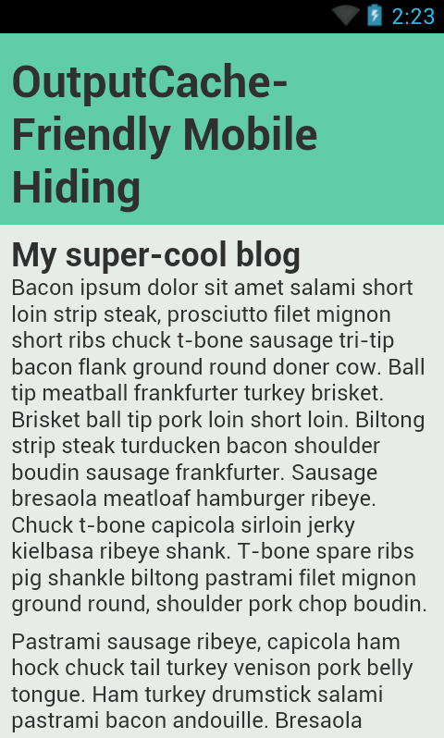
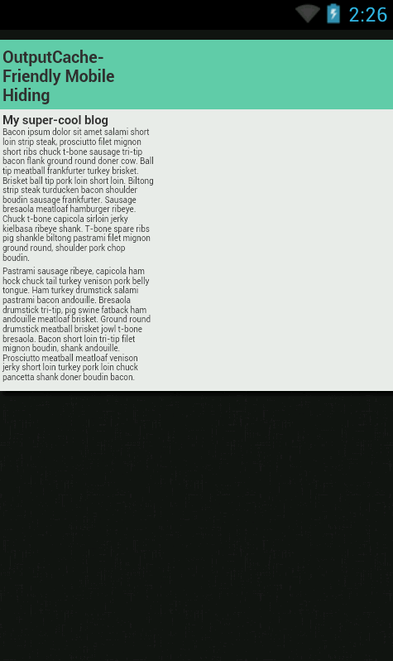
Viewport
width=device-width Defaults
Notes:
Layout Viewport
The Layout Viewport is defined by the CSS pixels available to the viewport
On a desktop when you resize the window you resize the layout viewport
Mobile layout viewport is set at load time and does not change (exception: scroll bars)
Mobile devices play some extra tricks with text wrapping – <div> elements will lay out correctly but the wrap point may be adjusted based on double-tap zoom size; text may re-wrap on zoom as well.
Visual Viewport
The visual viewport is the CSS pixel dimension of the visible area of the page
Desktop resize window resizes the visual viewport
Mobile zoom resizes the visual viewport
Quiz
Question: On the desktop, what will make the layout and visual viewports different?
Answer: Scrollbars
Viewport meta-tag for Mobile
Controls the layout viewport
Determines the number of device pixels per CSS pixel at zoom = 1 * this is the important concept to get your head around *
99% of the time, use the <meta name=“viewport” content=“width=device-width”> tag to define the width of your layout
Default iOS and Android layout viewport width is 980 CSS pixels, with initial scale set to match the visual viewport
Content attribute is comma-separated:
Width = [px|device-width]. Device width is “screen width in CSS pixels at 100% zoom”
Height – little-used
Initial-scale = multiplier
Maximum-scale = multiplier
User-scalable = [true | false]. Whether to allow the user to scale
CSS 2.1 recommends that CSS pixels correlate to one 96dpi pixel at arm’s length; initial-scale=1 requests this
IE10 METRO: ignores the viewport meta tag in Snap mode! You need to add the following to support Surface devices:
@-ms-viewport {
width: device-width;
}
Viewport relevance to Media Queries
width versus device-width
99% of the time you want width (CSS pixels)
Device-width can help you target specific devices (e.g. iPad, iPhone)
Note iOS reports *portrait* device-width & -height regardless of orientation (use the orientation query to differentiate)

Slide 15
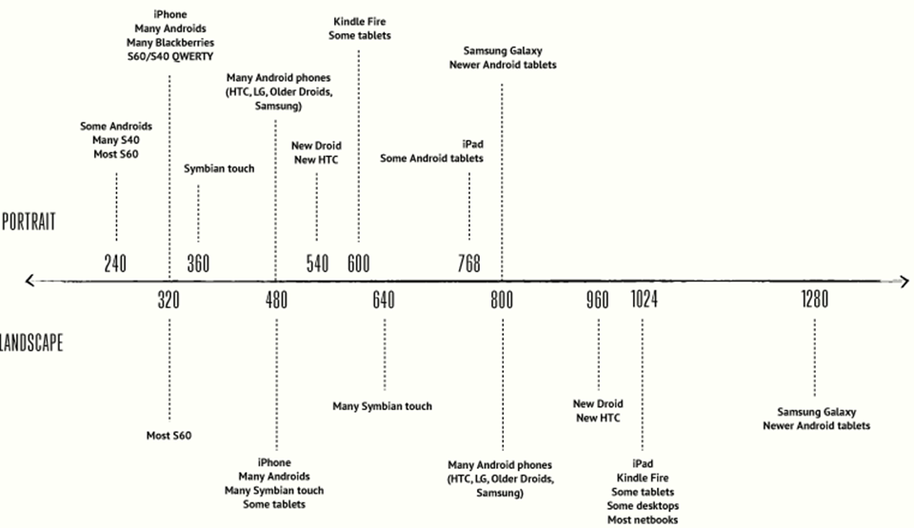
Finding Your Break Points
Credit: Viljami Salminen
Notes:
Source – Viljami Salminen’s blog:
http://viljamis.com/blog/2012/responsive-workflow/device-map-2012.pdf
There are WAY too many devices to design device-specific break points. You can choose too narrow a width and get cut-off on slightly larger devices; or you can choose too large a width and serve up a shrunken layout on a device that can handle more width.
The sweet spots are generally in the circled areas – let your content be your guide.

Slide 16
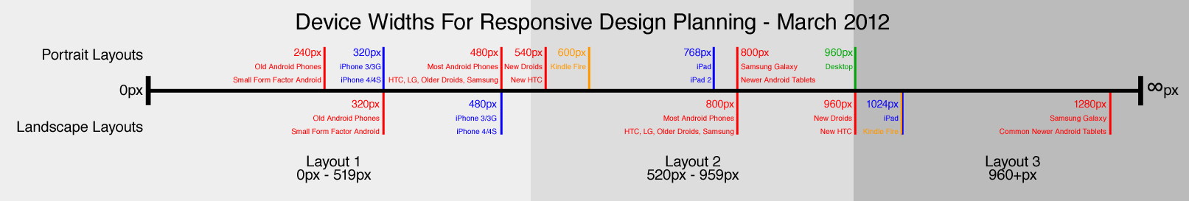
Three Layouts…
Credit: Adam Edgerton
Notes:
Source – Adam Edgerton’s blog:
http://www.metaltoad.com/blog/simple-device-diagram-responsive-design-planning
There is an ever-increasing number of devices with different screen resolutions to take into account with a responsive design, so Adam put together a simple but handy diagram that lists the most common device widths as of March 2012, along with overlays for potential device-width ranges.
This diagram shows three optimal device layouts:
Small: 0px to 519px
Medium-sized: 520px to 959px
Large: 960px and higher

Slide 17
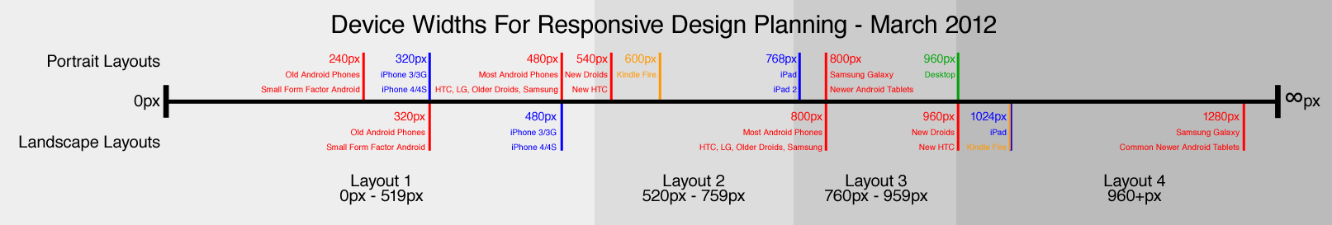
Four Layouts…
Notes:
This diagram shows four device layouts:
Small: 0px to 519px
Medium-rare: 520px to 759px
Medium-well done: 760px to 959px
Large: 960px and higher
Four layouts will be somewhat harder to maintain than three layouts, but it may be justified based upon your analysis of the your audience’s devices and the needs of your content.

Slide 18
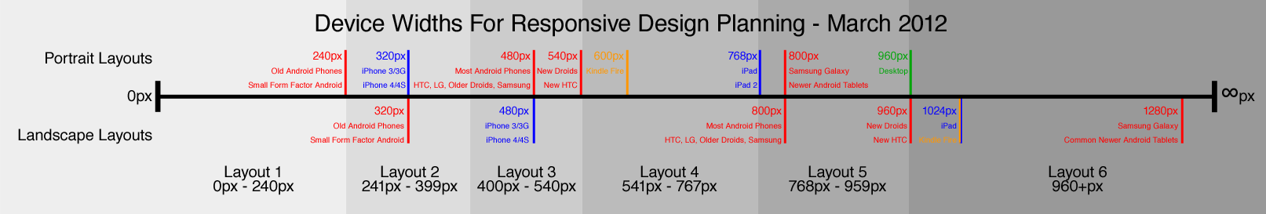
Six Layouts…?!?!
Notes:
Six layouts is hard to justify. Development, testing and maintenance costs will be high. Time to market will be slow as will turnaround times on revisions.

Slide 19
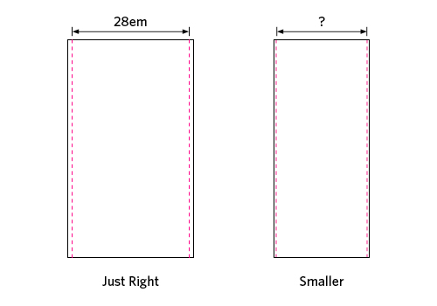
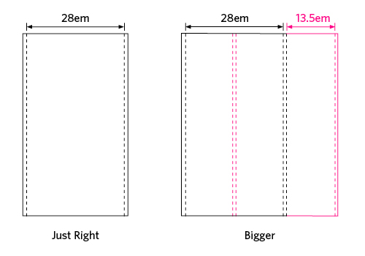
The Goldilocks Approach
Credit: Chris Armstrong
Notes:
The Goldilocks Approach
Choose a starting point (really big or really small) and start resizing until things look “wrong”
Set a break point for your content and then tweak it
Repeat
Three (3) sizes (small, medium and large) is a maintainable sweet-spot
The Goldilocks Approach by Chris Armstrong
http://goldilocksapproach.com/article/
Design from the “content out”, not from the “canvas in”
Going content-out means respecting the default base font size and scaling from there in ems. (See slide 4 notes for the definition of an em.)
Need to know some basic metrics: around 66 characters per line, ~30em is optimal for eye scanning from end-of-line to the beginning-of-the-next-line
Set max-width of main text content to 30em
With a “too big” screen, add text columns
With a “too small” screen, remove margins and hanging elements
Em units are pixel density-independent (think retina displays); they target the default size of the font on the device. Thus they lead to proportional perfection, rather than pixel perfection

Slide 20
Responsive Media
Images
Scale, crop, swap, omit?
SVG
Video
Scale
HTML5 <video>, Flash
Download alternatives
Audio
Scale
HTML5 <audio>, Flash
Download alternatives
Notes:
For Audio files supply MP3 and OGG, and fall back to Flash or a direct download link.
Tools
Media.IO will do the audio conversions for you:
http://media.io/

Slide 21
Responsive Images
Scale and Crop
Swap and Omit
SVG
Choose the right format
Encoding quality
Notes:
Scaling
Basic image scaling can be accomplished with width: 100% and max-width. IE7 has issues and will crop. (DEMO)
Cropping
Negative margins inside a container with overflow: hidden (DEMO)
Swap / Omit
Avoiding download
Textures are a good candidate
Swapping images can be accomplished client- or server-side:
Client-side with <noscript> approach
Server-side with an HTTP Module like ImageResizer (with responsive presets - https://github.com/mindrevolution/ImageResizer-ResponsivePresets)
Server-side with useragent-aware URL selection (DEMO)
SVG
Scalable Vector Graphics (SVG) is an XML-based vector image format for two-dimensional graphics that has support for interactivity and animation
SVG files are infinitely scalable at 100% quality
PNG fallback for IE (DEMO)
Other Bandwidth Tips
Choose the correct format! (PNG – logos/vectors; JPEG photos / realism; GIF – for <=IE6 PNG transparency workaround OR use CSS hack)
Lossless optimization of your PNGs can be achieved with PngGauntlet (http://pnggauntlet.com/) and there are plenty of others tools
Notes
Use Browserstack (http://www.browserstack.com/) or Virtual Machines to test old browsers against your site – the IE7 mode of IE10 does not show fallback
Photoswipe (http://www.photoswipe.com/) is a free HTML/CSS/JavaScript-based image gallery specifically targeting mobile devices. Use it when you need an image gallery for your mobile and touch devices users.

Slide 22
Responsive Video
An HTML 5 <video> tag inside a <div> Container – note the options and fallbacks:
<div id="video-container">
<video controls="controls" width="1280" height="720" title="vid" poster="x.jpg">
<source src="small.mp4" type="video/mp4" media="all and (max-width:480px)" />
<source src="file.webm" type="video/webm" />
<source src="file.mp4" />
<object …>
<a href="file.mp4“><img src="x.jpg“/> Download video</a>
</object>
</video>
</div>
$('#vid-container').fitVids(); // OR CSS
Notes:
HTML5 video with Flash fallback = Performance & Compatibility
If you use VP8 and H.264 encoded video files on you site, then that will cover nearly all user agents (browsers)
Omitting the type attribute from the final <source> tag will cause most browsers to check the metadata to determine if it can be played. Bandwidth/accessibility tradeoff. (The final <source> tag is the third one in the above example.)
You *could* use the little-known media attribute to serve smaller files to smaller devices. (Caveat: this <source> tag attribute may be dropped/deprecated at some point in the future.)
IIS NOTE: You need to add MIME types for video. You’ll get a 404.3 without it. (Web.config\system.webserver\staticContent\mimeMap)
Good resources:
Mark Pilgrim’s excellent, very in-depth (though now getting out-of-date) guide to HTML 5 Video: http://diveintohtml5.info/video.html
Concise, easy to read guide from JWPlayer: http://www.longtailvideo.com/support/jw-player/jw-player-for-flash-v5/22644/using-the-html5-video-tag/
Within the <video> tag, below the <source> elements, include an <object> element for Flash fallback and video download link (for users without Flash):
FlowPlayer (http://flowplayer.org/) is a nice option. (Caveat: issues with FlashFox resizing.)
Within the <object> tag, supply a final fallback download link for devices with neither video nor plugin support
“Video for Everybody” is a nice tool for generating markup: http://camendesign.co.uk/code/video_for_everybody
Use JavaScript and/or an HTTP module with user agent detection to serve the appropriate codec and file size to the user’s device
Third-party
Don’t discount the option of hosting your video externally (Vimeo, Youtube) and IFRAME-ing in a video player – these companies have solved the cross-browser problem and they will take bandwidth and connection pressures off of your server.
Flexible sizing
For the <video> tag, you can rely on width = 100% and max-width, with height auto to flexibly resize video while maintaining aspect ratio
Flash and IFRAMEs have issues – you can’t automatically set height to preserve the aspect ratio
Thierry Koblentz’s “Creating Intrinsic Ratios for Video” to the rescue! - http://alistapart.com/article/creating-intrinsic-ratios-for-video
Set a wrapper <div> with relative position, zero height, and bottom-padding representing the aspect radio (e.g. 56.25% == 16:9)
Set an inner <div> absolutely positioned with 100% width and height
This technique has issues in IE7 and below – so use a conditional style sheet to detect for and workaround old IE browsers
DEMO
Server-side detection of the User Agent and dynamic creation of the <video> tag

Slide 23
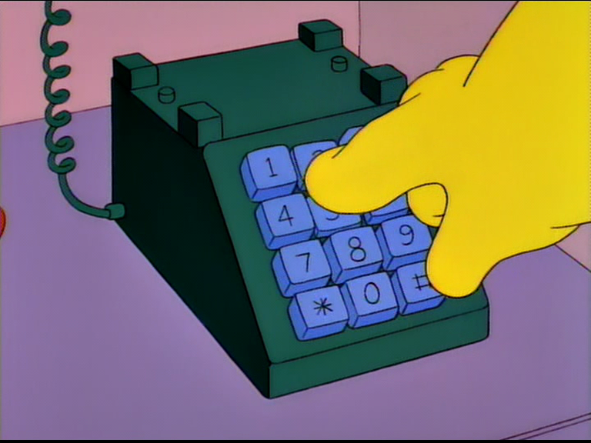
Responsive Forms
Label alignment
Touch-friendly
Input types
“To order a special dialing wand, please mash the keypad with your palm now.”
Notes:
Note “field zoom” feature of many browsers:
Makes top-aligned labels better, otherwise label or field may be cut off
Input { font-size: 1em } to avoid extra zoom on iDevices – lower font will zoom
Touch-friendly:
Sizing (finger targets)
Click versus Touch events (WARNING re: Kindle Fire, see FT Fastclick: http://labs.ft.com/articles/ft-fastclick/)
Input Types:
To show special keyboard layouts - Email, url, tel, etc.
WARNING – may apply some browser-native validation
DEMOS
Use BrowserStack for a virtual keyboard
Show double-touch fire in Electric Plum (http://www.electricplum.com/) and then un-comment preventDefault

Slide 24
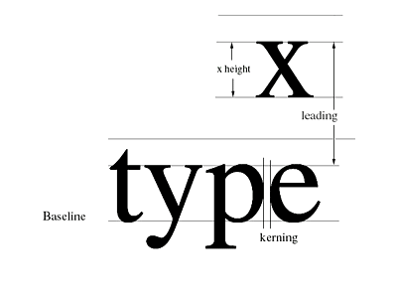
Typography
Respect the user agent
Display density
Metrics: font size, contrast, line height, line length, spacing, hyphenation
“A useful trick is to hold a well-printed book at a comfortable reading distance while looking at your website to compare.” – attrib
Web fonts – browser and device quirks
Source: BrightLemon.com
Notes:
Default Font Size
The user (or at least the user’s operating system or browser) has already specified the preferred default font size for the device. Rather than overriding this, we should respect it as a base and scale from there.
Display Density and Pixel Density
New “retina” class devices and HD displays can make pixel sizing unreliable, and the future of the “pixel” is uncertain
Adjusting weight by density to achieve a uniform result (as density increases you need to use a bolder weight to achieve the same perceived weight) – relates to antialiasing
On standard-density displays, serif fonts below 12px are not sharp enough, but you should be over 12px anyway
Metrics
Font size: bigger than you think. Hold a book or a magazine up at a comfortable distance and compare
Contrast: ratio font color to background brightness. Steer clear of full black (looks like a “hole”) and steer clear of full white.
Line Height: for text, 140% of font size is a good general rule, but it depends on the font face (ascender/descender ratio to x-height and “blackness”); proportional line-height (font: Arial 1em/1.44) with no units
Line Length: From 45 to 75 characters per line is a good balance between ease of tracking between lines versus not having to track too often. When browsers support it, you can use the CSS3 column count when the view gets very wide. You can leave width “on the table” and set a max-width; also you want to ensure that text blocks have good height in proportion to width.
Spacing: Headings often need more space to breathe
Web Fonts
TrueType (TTF) is an outline font standard developed by Apple and Microsoft in the late 1980s as a competitor to Adobe's Type 1 fonts used in PostScript. It has become the most common format for fonts on both the Mac OS and Microsoft Windows operating systems.
OpenType (OTF) is a format for scalable computer fonts. It was built on its predecessor TrueType, retaining TrueType's basic structure and adding many intricate data structures for prescribing typographic behavior. OpenType is a registered trademark of Microsoft Corporation.
The Web Open Font Format (WOFF) is a font format for use in web pages. It was developed during 2009 and is now a World Wide Web Consortium (W3C) Recommendation.
Embedded OpenType (EOT) fonts are a compact form of OpenType fonts designed by Microsoft for use as embedded fonts on web pages. These font files can be created from existing TrueType font files using Microsoft's Web Embedding Fonts Tool (WEFT), and other proprietary and open source software.
Gotchas
Note that when using fluid (proportional) layout techniques you give up some control over the line length
Web Font browser quirks:
Rendering differences
Format support
The MIME type for Web fonts is (still) problematic. If you are serving your own fonts (using IIS or Apache) then you may want to try setting the following MIME types for the following vector graphic types and web fonts:
svg as "image/svg+xml"
ttf as "application/x-font-ttf" or "application/x-font-truetype"
otf as "application/x-font-opentype"
woff as "application/font-woff“
eot as "application/vnd.ms-fontobject"

Slide 25
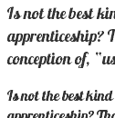
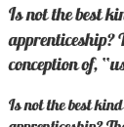
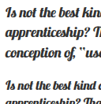
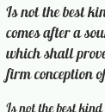

Fonts – Browser Quirks and Gotchas
Chrome 23 IE10 Firefox 16 Android 4.1
Selected text-shadow
Notes:
The same font (Lobster, in this case) looks different in different browsers, despite the fact that the web server is distributing the same font file (Lobster.otf) to each of the browsers.
Try FontSquirrel (http://www.fontsquirrel.com/) for free web fonts and known-good CSS

Slide 26
Other Techniques
Mobile click event latency (touch events)
Keyboard hotkeys
Bundling and minification (System.Web.Optimization)
Notes:
DEMOS
Click latency: show the Responsive Form demo
Hotkeys: show the Hotkeys demo
Bundling and minification: show the debug/release demo

Slide 27
Responsive Web Design Case Study
Workflow:
Identify the goals and value proposition(s) for your site
Understand your users and their reasons for coming to your site
Gather, develop, organize and prioritize your content
Create wireframes and find the best “break points” for your content: small, medium and large
Implement server-side logic to serve smaller media files to mobile devices
Enhance, enhance, enhance
Notes:
Here’s a compact summary of the process recommended for Responsive Website Development. In many ways the process is the same as the recommended approach to traditional website development. The difference is really in the fact that you’re going to be designing two or three versions of your site – small, medium and large – and to do this effectively you need to understand how your content can adapt or be adapted to these different form factors. Additionally, you will likely be using a Responsive Web Design framework along with (potentially new) server-side techniques for shrinking content for mobile users.

Slide 28
Case Study: Before
Notes:
When viewed on tablets and smartphones the Masters of the Universe Band site suffers from:
Content issues
Design issues
Either the design looks wrong or the content is rendered way too small in real pixels rather than in device pixels.

Slide 29
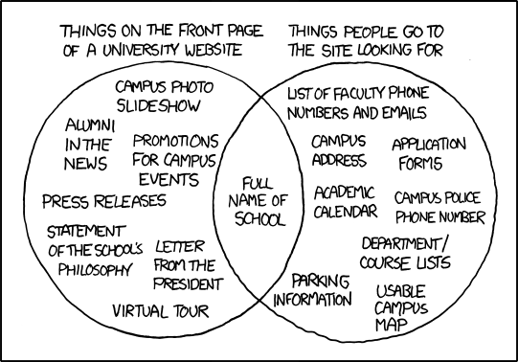
Case Study: Focus on Value
http://xkcd.com/773/
Notes:
Try not to be the subject of a cartoon like this one from XKCD – this one has made the rounds. Analyzing your web logs can help you understand what your website visitors are looking for. If your site is totally new, be prepared to adjust your homepage as you get a better understanding.
Tag each activity (use case or user story) that your web site delivers with the device(s) on which the activity is likely to be performed. A general rule is that desktop and notebook users will (likely) want to create inputs to your website, while tablet and phone users will mostly want to consume content. Certain activities may simply not be feasible on mobile devices. It’s acceptable to deliver both simplified content and a simplified user experience to mobile users.

Slide 30
Case Study: Understand your Site Visitors
Identify your Users:
Repeat visitors
Organic search
Active search
Identify the primary reason the user is visiting:
Repeats: hear old and new songs
Organic searchers: He-Man
Active searchers: hear songs, read info, see videos
Identify the activities that will engage the user:
Hearing music
Viewing pictures
Reading copy (Bios, About)
Notes:
Items are ordered by rough probability / priority and this analysis uses the Masters of the Universe Band site as an example

Slide 31
Case Study: Collect Content
Isolate your copy
Curate your copy
Isolate your media
Curate your media
Process your media
Notes:
Process Recommendation: don’t forget to add metadata to your media/content. See Slide 34 for more on this.

Slide 32
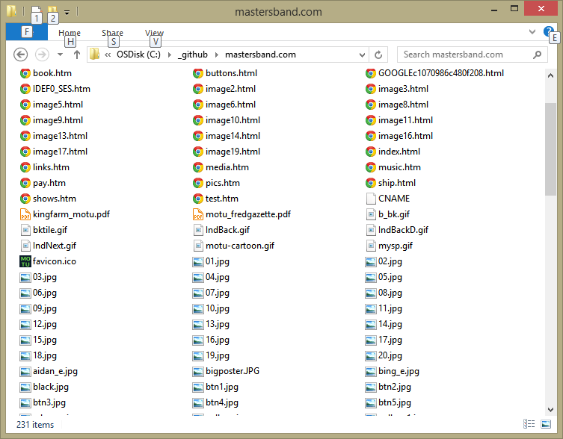
Notes:
Here is all our content for the Masters of the Universe Band site collected in one folder

Slide 33
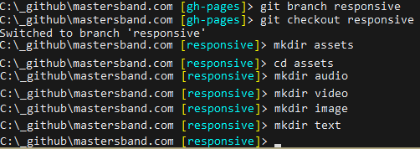
Notes:
Here we’re using the GitHub command line to create an assets folder with sub directories for audio, video, image, and text
Recommendations
Use big content buckets, i.e. don’t go too crazy classifying your content. Basic content types are fine.
Be able to bulk sort your content. Using thoughtful names and naming conventions as you add content to your buckets.
Inspect and trash judiciously. You will discover stuff you forgot you had!

Slide 34
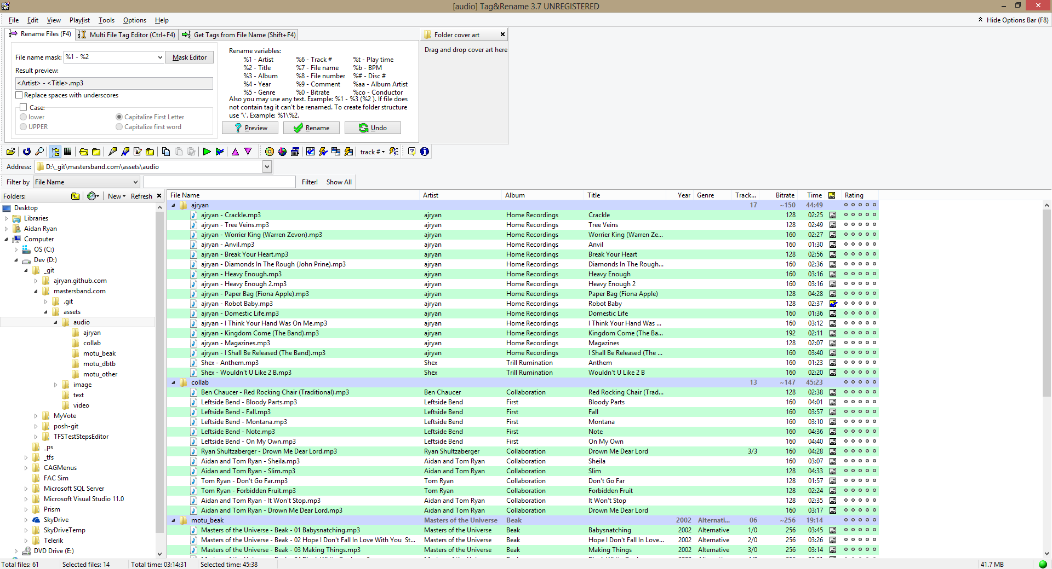
Notes:
Don’t forget metadata. Tools help here!
Fotosizer is a great utility for batch image resizing:
http://www.fotosizer.com/

Slide 35
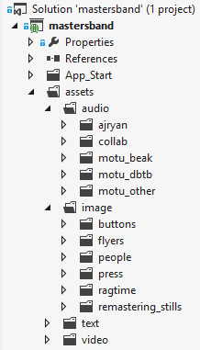
Case Study: Content Organization
Copy: isolated, culled, consistently named
Image sets: sorted, culled, consistently named, full-size and scaled
Audio: sorted, culled, consistently named, with ID3 tags embedded
Video: full-bitrate and down-sampled
Notes:
Here the content has been appropriately culled and organized into meaningful folders and subfolders. Note that the subfolder structure is following traditional guidelines of either being aligned by page or site section or being aligned by media type.

Slide 36
Case Study: Content Presentation Sketches
Index card sitemap
Paper sketches / storyboard
Move to HTML Skeleton ASAP
CSS Reset
Type ramp
Notes:
The “rough and ready” approach you’ll see in the following slides helps to flesh out the initial site structure. Iteration is more important than designing things perfectly and getting something to work with will lead to a final design.
Take the “Goldilocks” approach to your content and pay less mind to any specific width imposed by devices. Again, you’re looking for small, medium and large versions of your layouts.
Type face plays a very prominent role in responsive web design. Early decisions about type will make your layout decisions easier and reduce future rework.

Slide 37
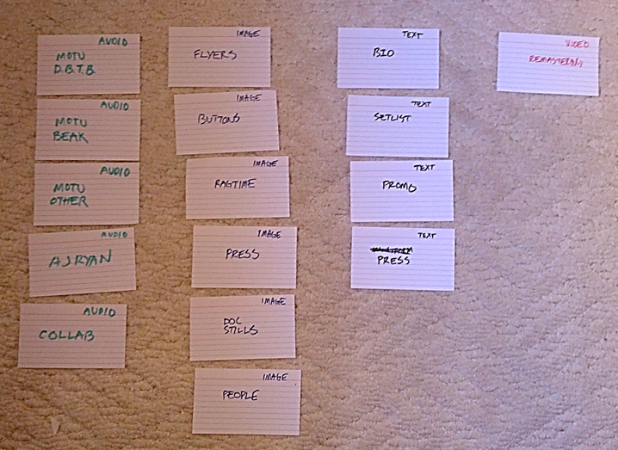
Notes:
Here is a site map illustrated by Index Cards

Slide 38
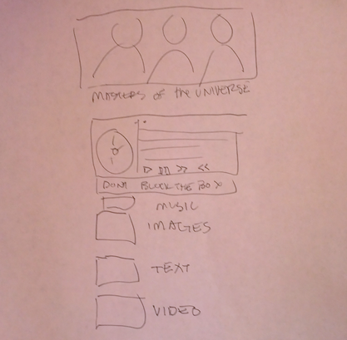
Notes:
First rough version of the home page that will work for small, medium and large layouts.
Key decision: The home page layout will be proportionally the same across small, medium and large versions of the site
Key decision: Play music from the current album on the home page (the second box down is a music player) as this is what most of the site’s users will want to do

Slide 39
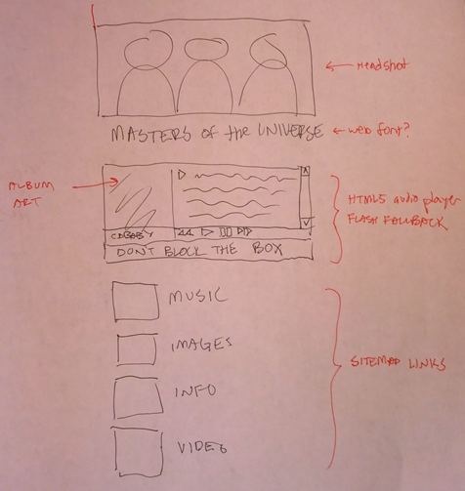
Notes:
Refinement of the home page after pitching the initial design to the stakeholders

Slide 40
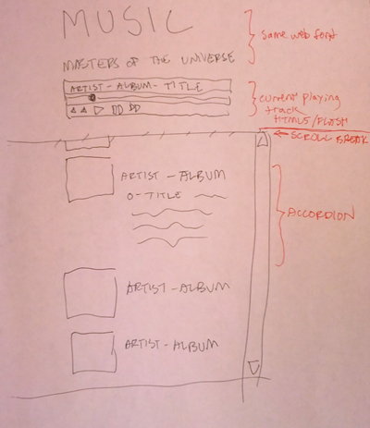
Notes:
The Music section of the site where users will go to listen to songs from the current album and from past albums

Slide 41
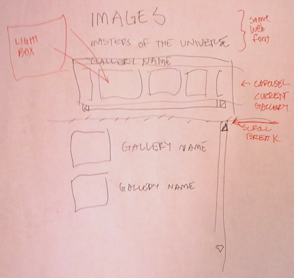
Notes:
The layout for the Image Gallery for the site.
Again a great tool for Photo Galleries is Photoswipe (http://www.photoswipe.com/). It’s a free HTML/CSS/JavaScript-based image gallery specifically targeting mobile devices.

Slide 42
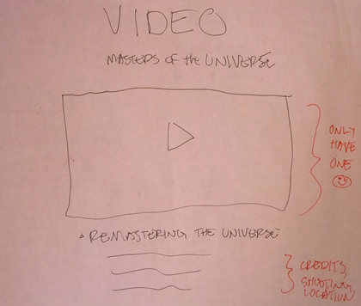
Notes:
The Video section of the site. Note that the masthead image has been dropped in favor of the key frame from the landing page video.

Slide 43
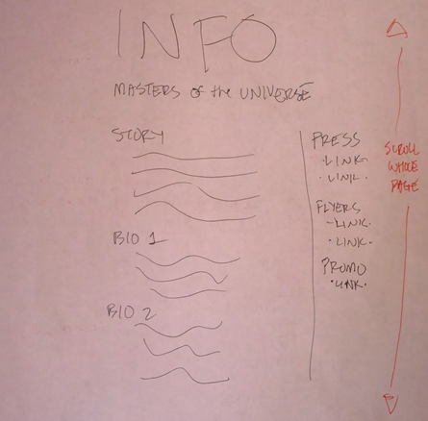
Notes:
The Info page. Note that this page has been designed to scroll.

Slide 44
Case Study: ASP.NET MVC 4 Skeleton
Start with an “Empty” project
Strip out Web API and other unneeded NuGet packages
Add the master layout:
Style bundle (normalize.css + site.css)
HTML5shiv
Minimal layout

Slide 45
Case Study: ASP.NET MVC 4 Master Layout
@using System.Web.Optimization
<!DOCTYPE html>
<html>
<head>
<meta charset="utf-8">
<meta http-equiv="X-UA-Compatible" content="IE=edge,chrome=1">
<meta name="viewport" content="width=device-width">
<title>Masters of the Universe</title>
@Styles.Render("~/CSS/styles")
<!--[if lt IE 9]>
<script src="~/JavaScript/html5shiv.js"></script>
<![endif]-->
</head>
<body>
<div class="page-center">
<header>
<div class="hero">@RenderSection("hero", true)</div>
<h1 class="logo">Masters of the Universe</h1>
</header>
@RenderBody()
</div>
</body>
</html>
Notes:
ASP.NET MVC 4 has the concept of a master page layout, into which you will render the content of individual pages.
The master page layout gives you the ability to:
Set a common <head> section with common <meta> tags including the viewport meta tag
To identify where you will render Cascading Style Sheets (CSS) and JavaScript scripts. Generally, style sheets must go in the <head> element whereas scripts can go in the <head> or the <body> element after your content. Placing your scripts in the <body> element, after your content, can speed up the perceived load time of your page. However if the page content calls any of the scripts on loading, e.g. a reference to a jQuery variable, then you’ll need to put your scripts in the <head> element. Note that the style sheets and scripts that are rendered can be (are usually are) decided on a per page basis by the View Controller for each page; the master page merely determines where on the page the CSS and Scripts should be rendered.
To set a common masthead or a common footer for the site.

Slide 46
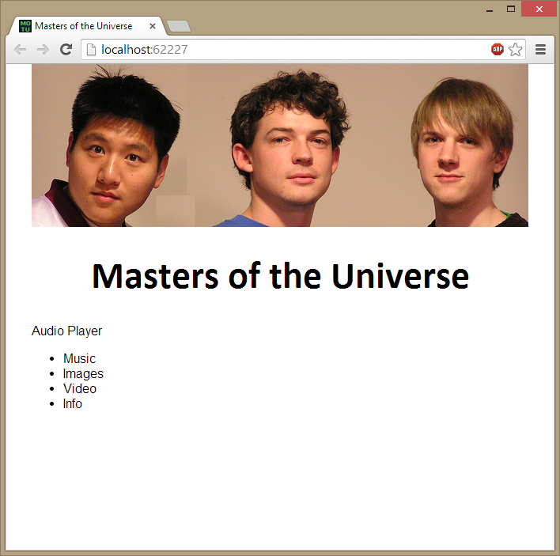
Notes:
First draft of the home page in HTML form

Slide 47
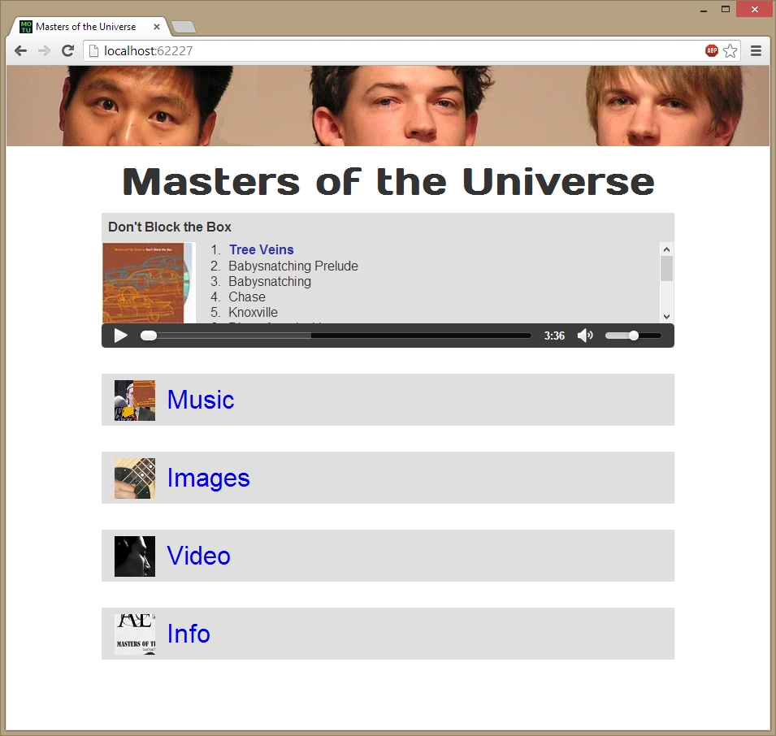
Notes:
Fleshing out the home page…
Key Decision: the font

Slide 48
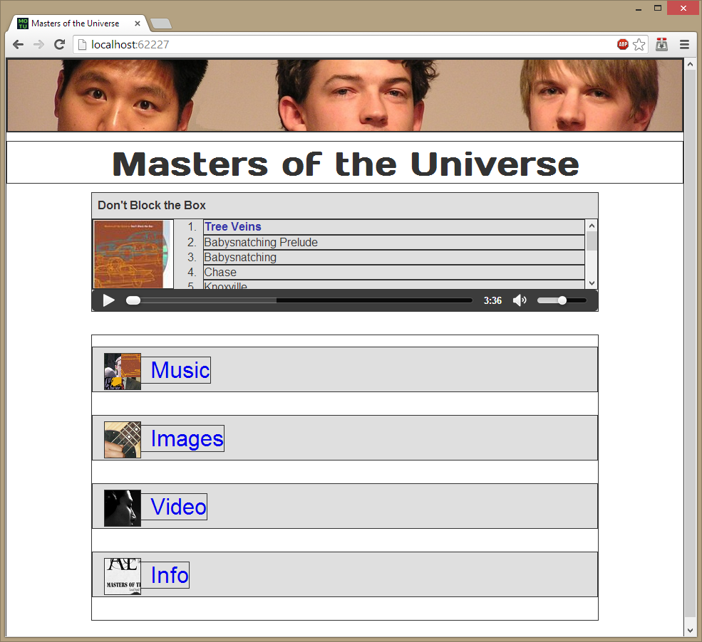
Notes:
The homepage skeleton with minimal nesting that will allow for simple reflow/positioning.

Slide 49
Case Study: Enhance the Layout for Mobile
Position
Type Size
Padding/Margins
Remove non-essentials
Notes:
A stripped down layout is a must for Mobile devices; make your site as “lite” as possible.
Use server side browser detection to decide whether to send the “small” or “full-size” version of your images and video. Use a suffix e.g. “-small” in the filename for your content so that the server just has to know the suffix in order to serve the small version of your files.
http://51degrees.mobi/ is your friend.

Slide 50
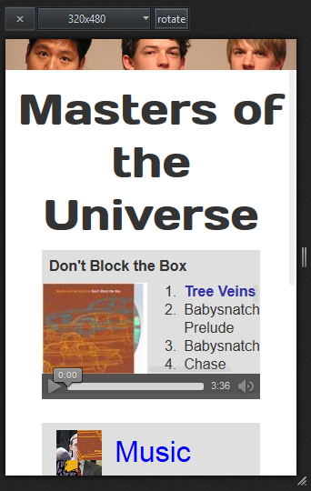
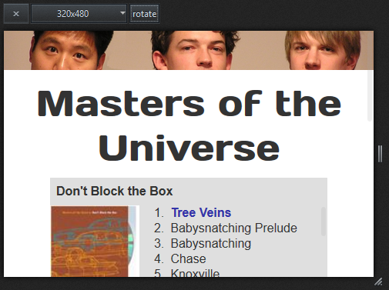
Before
Notes:
Use device emulators to preview your design on touch devices:
Head is stealing space
All fonts can drop size (need mobile ramp)
Margins stealing from player
Margins too big on menu links

Slide 51
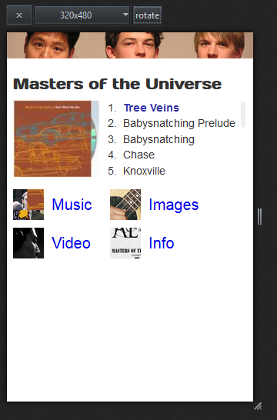
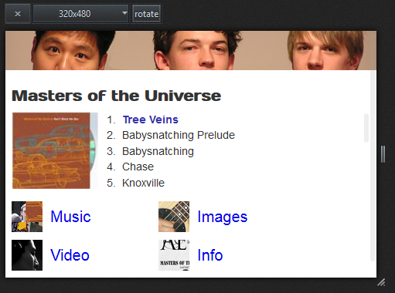
After
Notes:
We used server-side device detection (51degrees) to remove audio controls – we can’t do this with just CSS. We’ve also decided to use a JavaScript play/pause button on the album cover; we’ll enhance this later with a glyph overlay on the album cover to indicate the control.
No scrollbars will be required on the home page at its smallest layout on mobile devices.

Slide 52
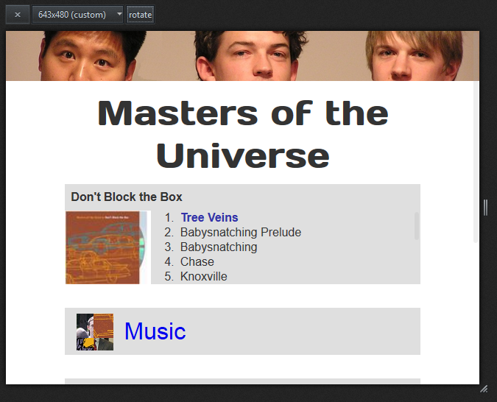
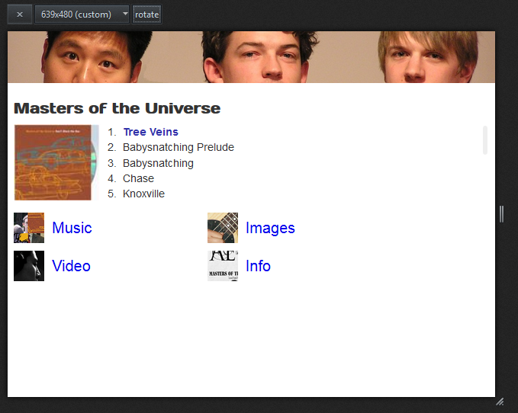
At the break point →
Notes:
At a break point: 643 x 480 (on the left) versus 639 x 480 (on the right)

Slide 53
Case Study: Enhance Layout for Wide Desktop
Position
Type Size
Avoid content islands
Creative use of space
Notes:
We took a “mobile first” – actually a “tablet first” – approach to designing the home page. Now let’s look at how we can optimize the design for desktops which have larger screens and (generally) greater bandwidth.

Slide 54
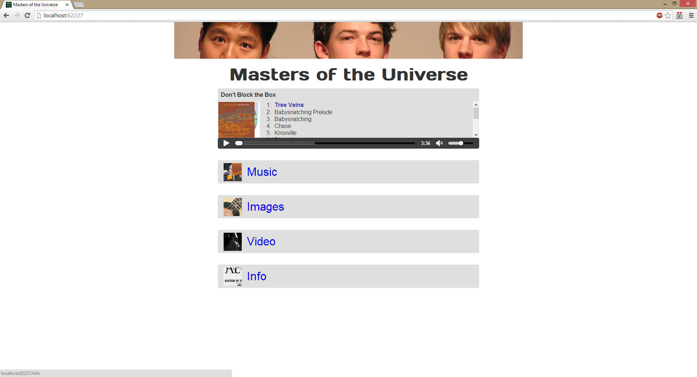
Notes:
Here’s the home page displayed on a large desktop monitor. We’ve got a lot of empty space.

Slide 55
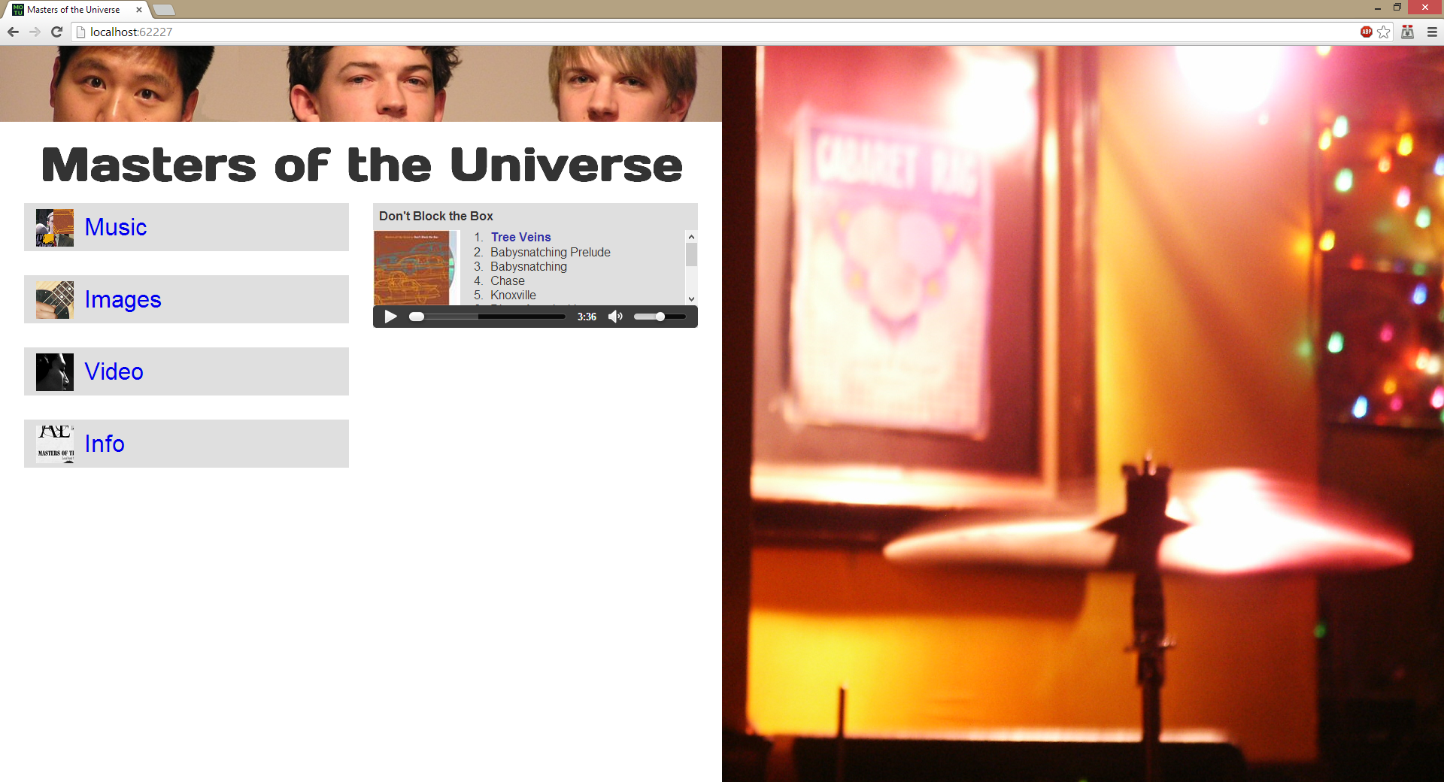
Notes:
Let’s add a sidebar image? What about all that white? Let’s add some more detailed styling.

Slide 56
Case Study: Detailed Styling and Interactions
Textures, shadows
Touch, input types
Notes:
All of these can be tuned by device in a bandwidth-friendly manner

Slide 57
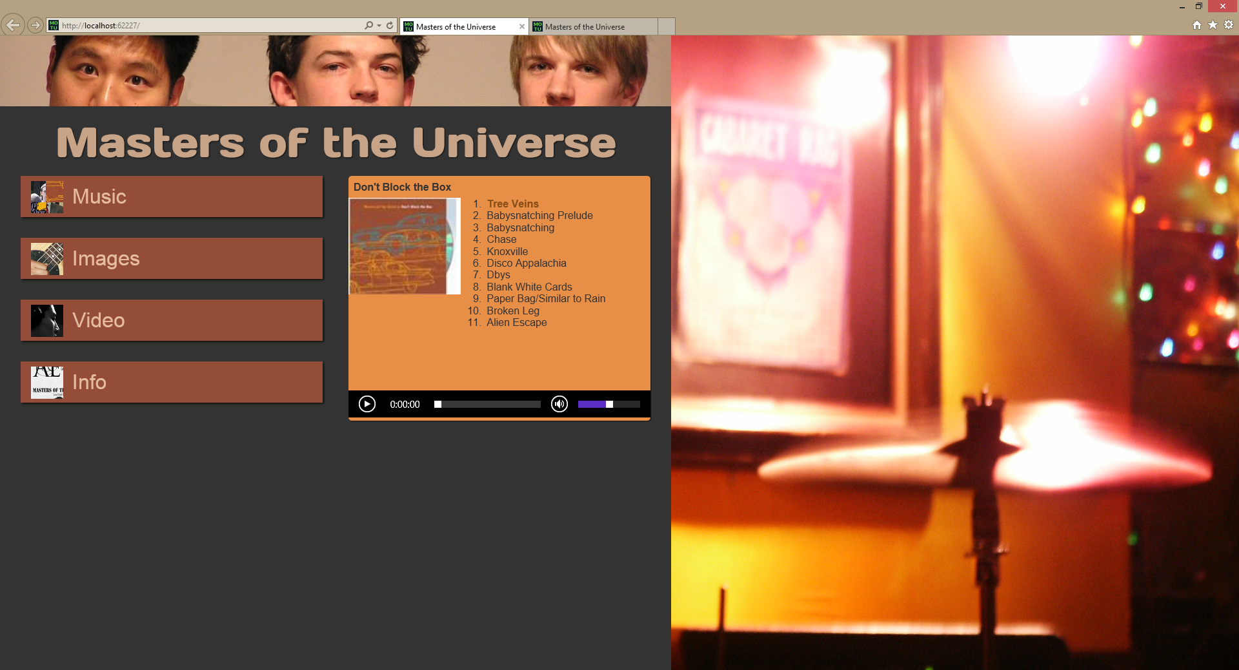
Notes:
Here are the results of adding more detailed styling to the desktop experience

Slide 58
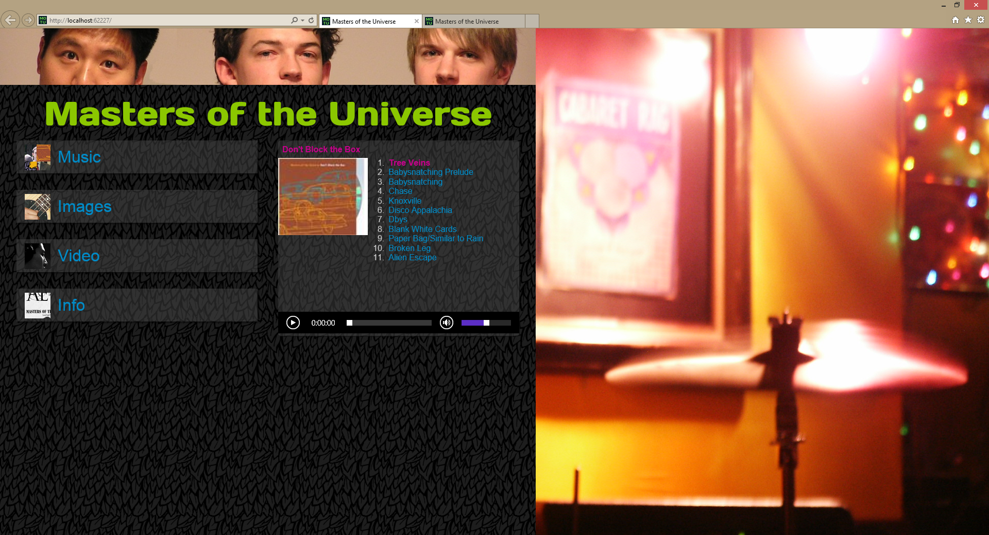
Notes:
Here’s a revision of the styling using new font colors and a texture – a texture you’ll find on most guitar amplifiers and speakers, by the way.
Palette from:
http://www.colourlovers.com/copaso/ColorPaletteSoftware

Slide 59
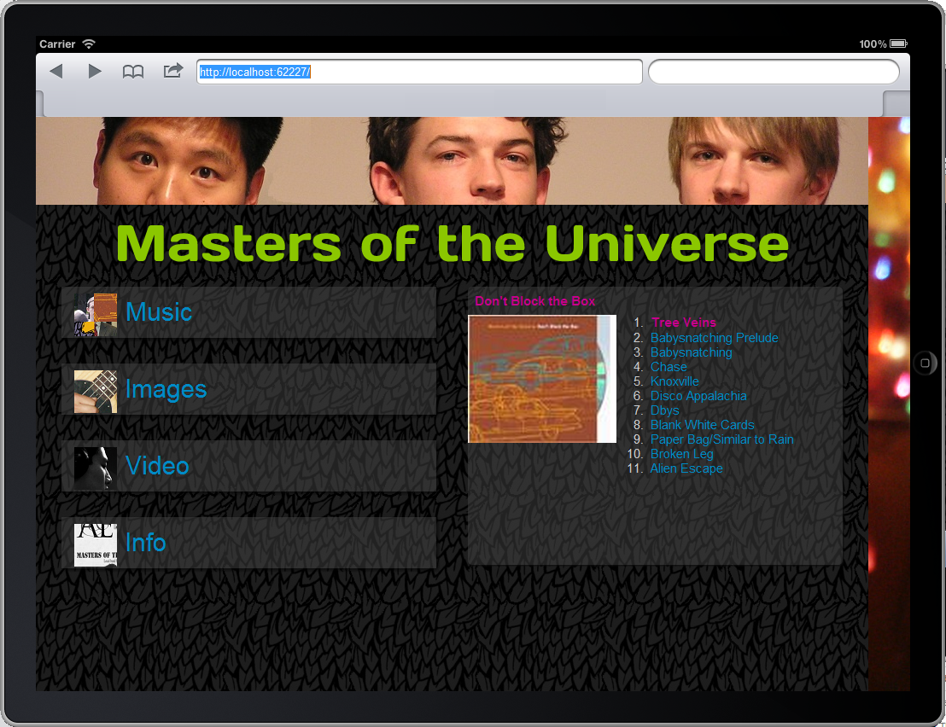
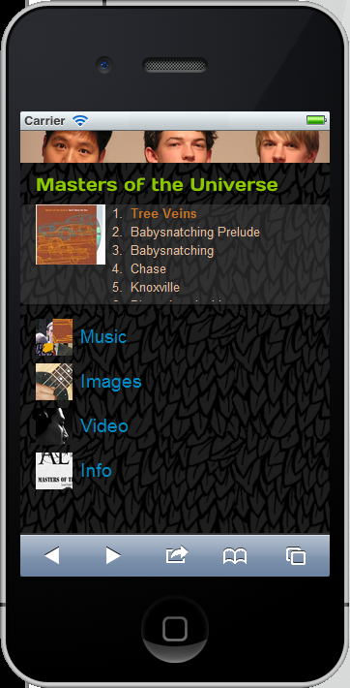
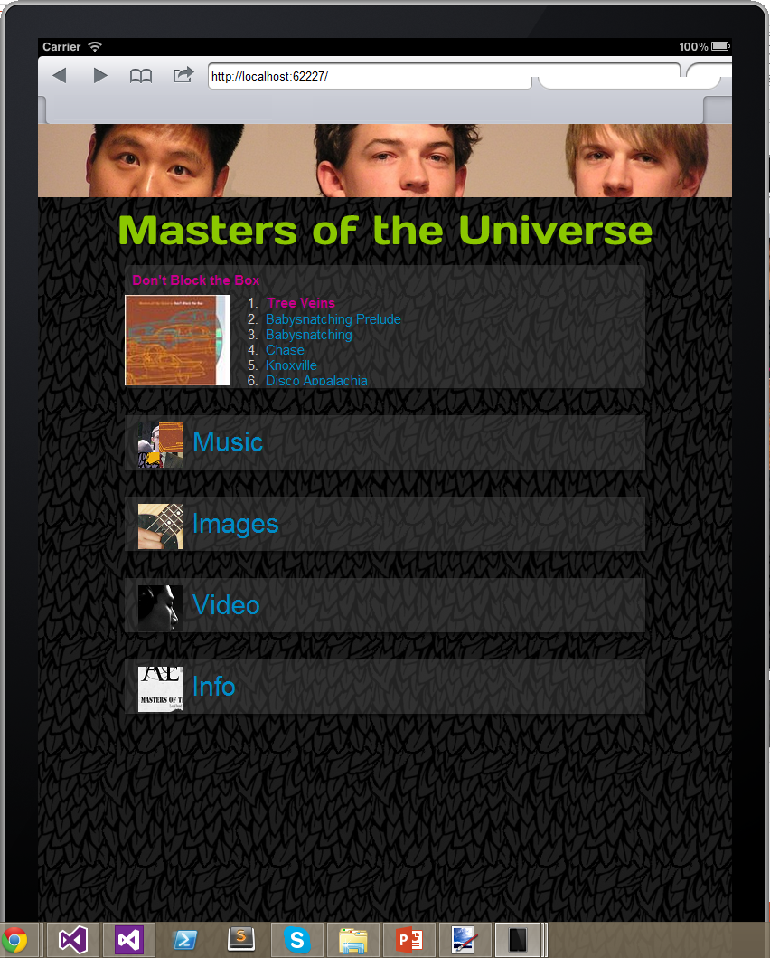
Notes:
Let’s “proof” the new layout on touch devices using emulators

Slide 60
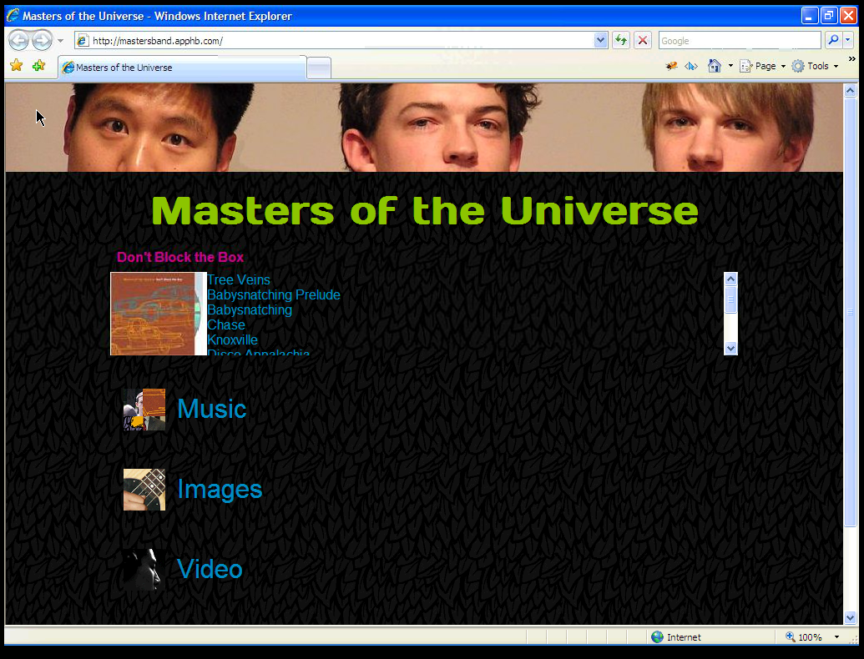
Notes:
Let’s go back in time and view the site on Windows XP with IE7 by firing up a Virtual Machine and pointing it at the site

Slide 61
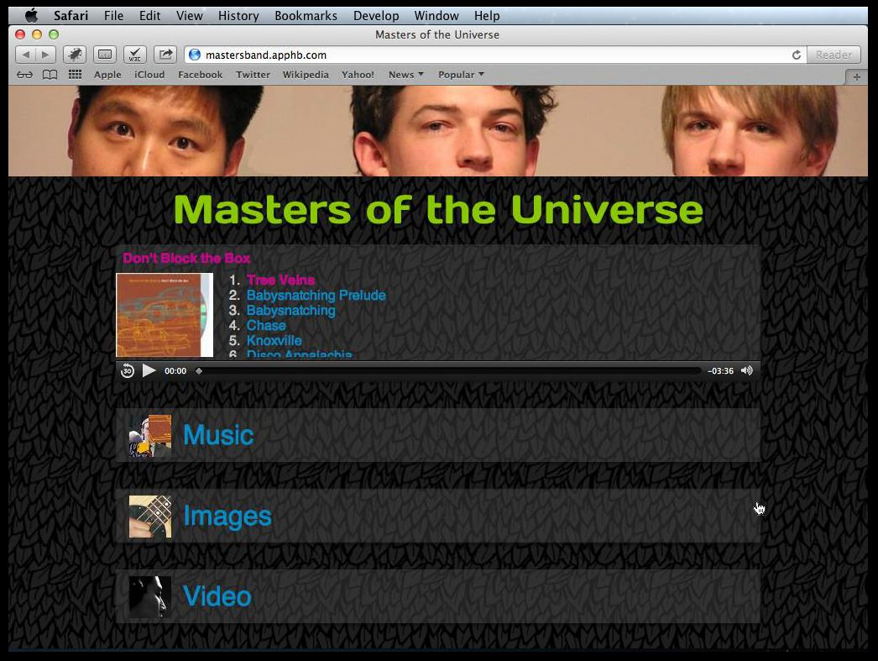
Notes:
Let’s proof the site’s layout on Apple OS X Mountain Lion with Safari 6

Slide 62
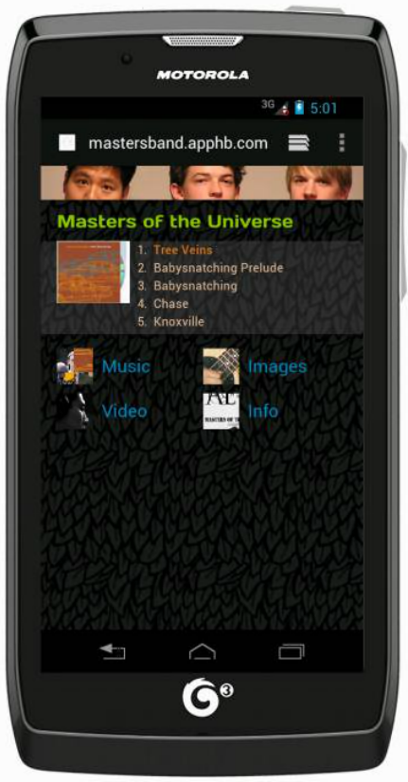


Notes:
Let’s proof the site on various smartphone platforms using the SpringBox preview tool for mobile development:
http://springbox.com/mobilizer

Slide 63
Case Study: Test, test, test
Testing tools:
WatiN / Selenium
Device simulation:
BrowserStack
Electric Mobile Studio
Mobilizer
VirtualBox
Simulators will only take you so far
Notes:
Testing Tools and Device Simulation
BrowserStack – a live web-based browser testing tool:
http://www.browserstack.com/
Scott Hanselman’s Blog entry on the BrowserStack Visual Studio Extension:
http://www.hanselman.com/blog/CrossBrowserDebuggingIntegratedIntoVisualStudioWithBrowserStack.aspx
SpringBox – a preview tool for mobile development:
http://springbox.com/mobilizer
Photoswipe – an image gallery for mobile and touch devices:
http://www.photoswipe.com/

Slide 64
Code Samples
https://github.com/ajryan/CodeCamp2013 (Code)
http://codecampresponsive.apphb.com (Live demos)
http://mastersband.apphb.com (Responsive re-design)
Notes:
Thank you for your attention! We hope this was worthwhile!

